Slide 1
Aplikasi Pengajuan Cuti
Oleh Felix Candra & Rahmat Darmawan

Slide 2
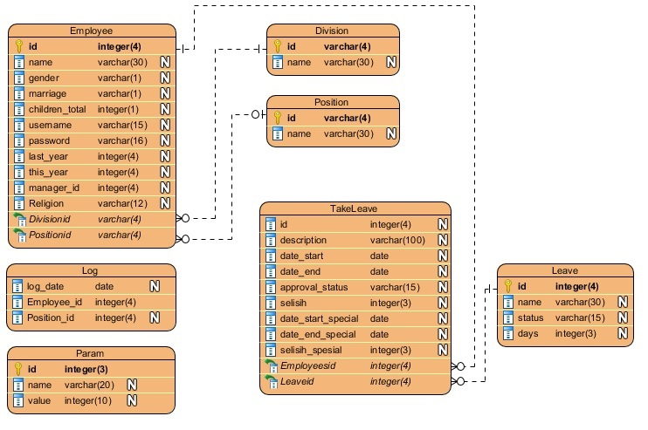
Entity Relationship Diagram

Slide 3
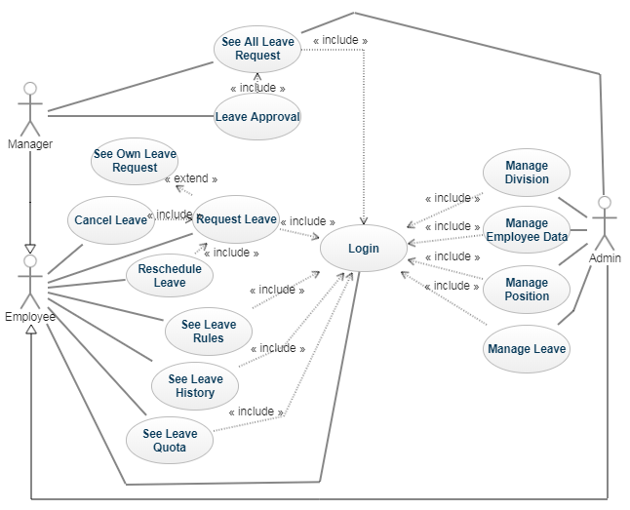
Use Case Diagram

Slide 4
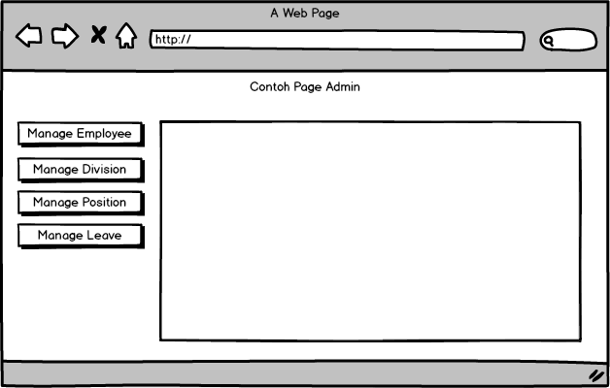
User interface

Slide 5
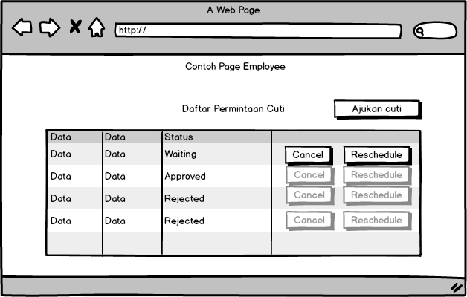
User interface

Slide 6
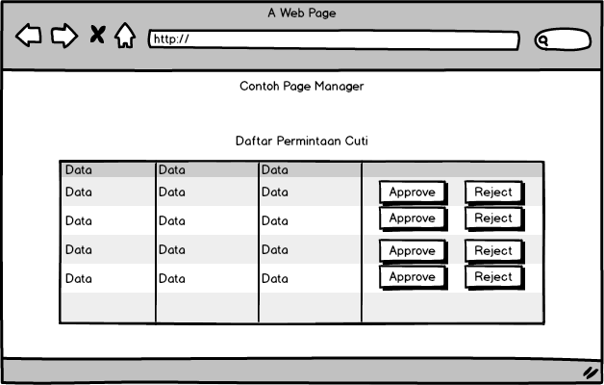
User interface

Slide 7
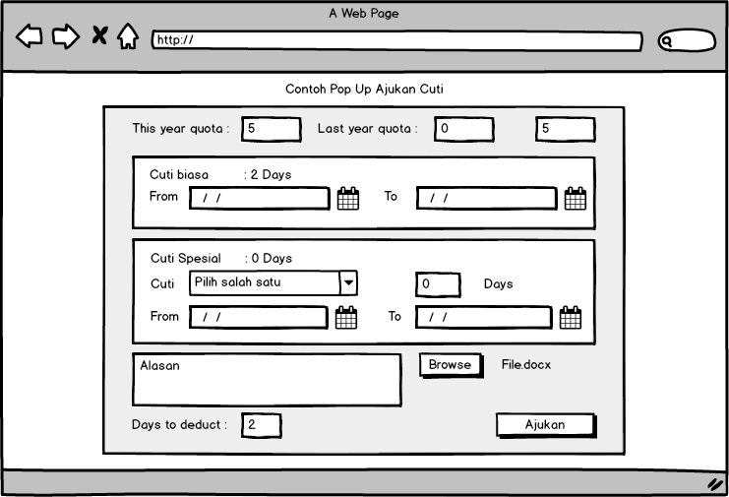
User interface

Slide 8
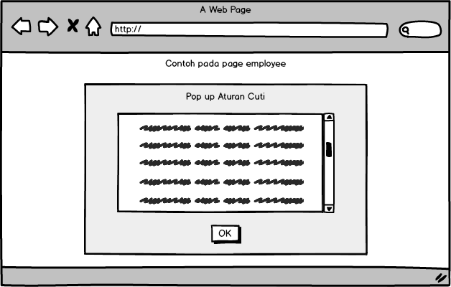
User interface

Slide 9
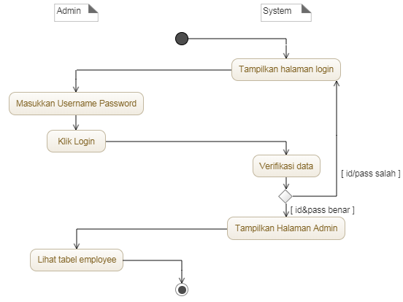
Activity Lihat tabel employee

Slide 10
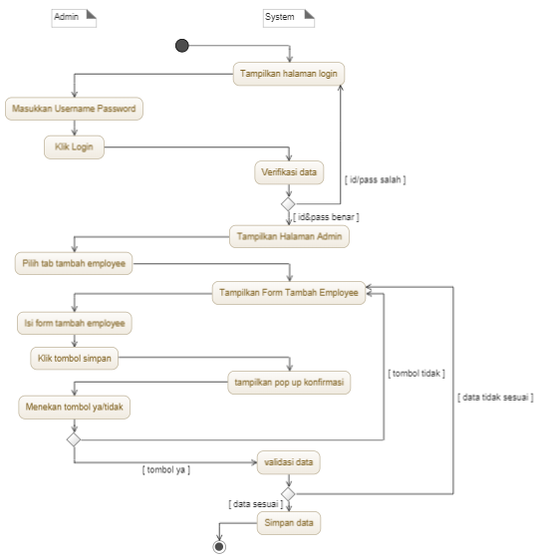
Activity Tambah employee

Slide 11
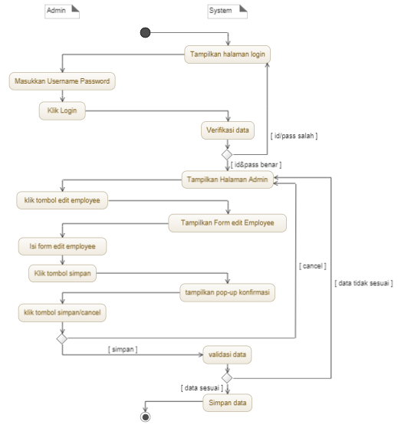
Activity Edit employee

Slide 12
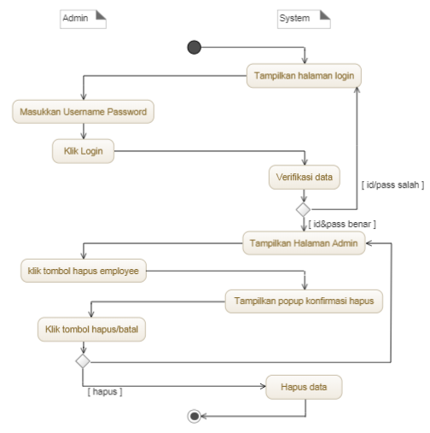
Activity hapus employee

Slide 13
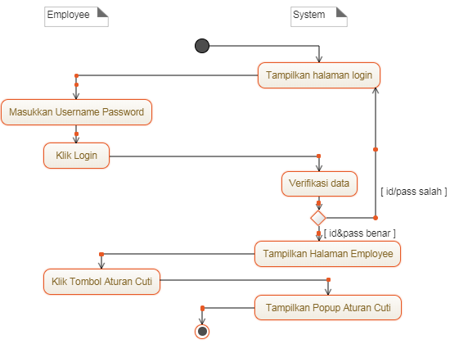
Activity lihat aturan cuti

Slide 14
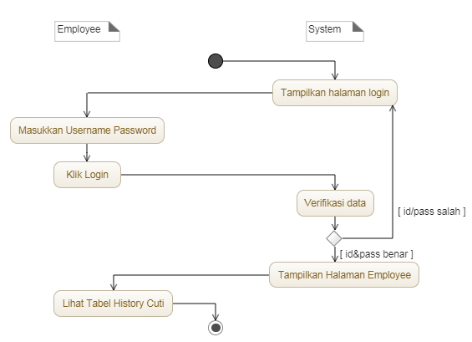
Activity lihat history cuti

Slide 15
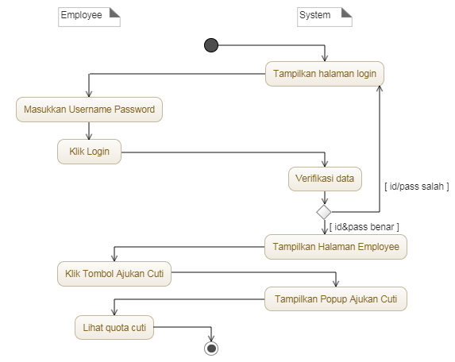
Activity lihat Quota cuti

Slide 16
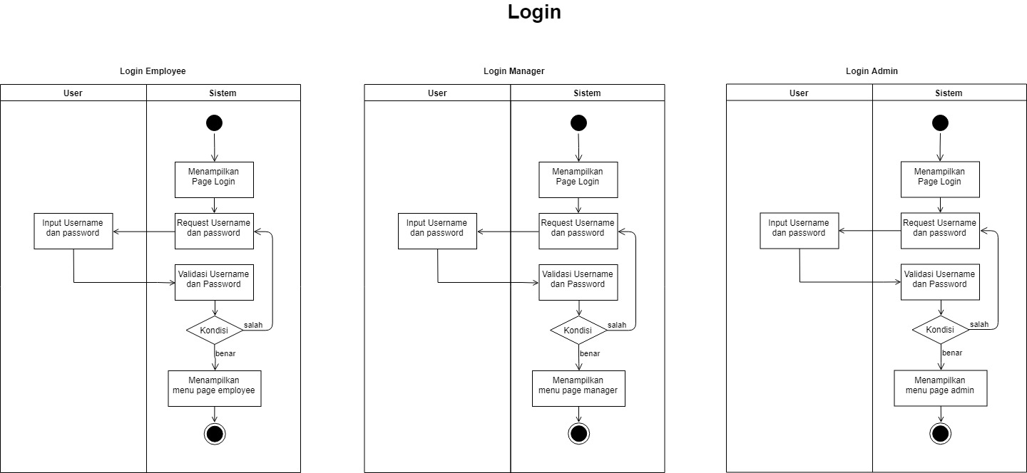
Activity Login

Slide 17
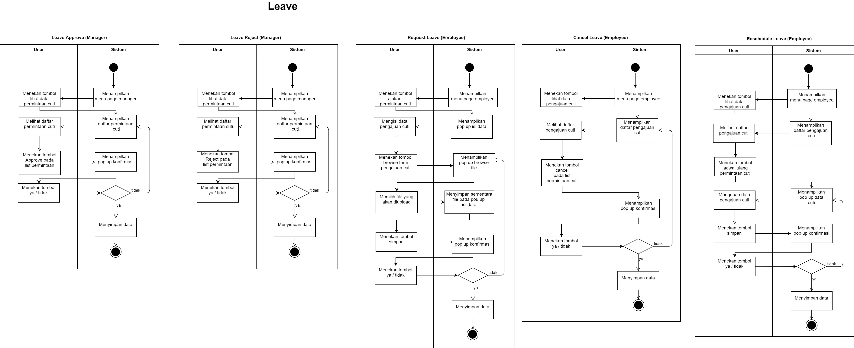
Activity Leave

Slide 19
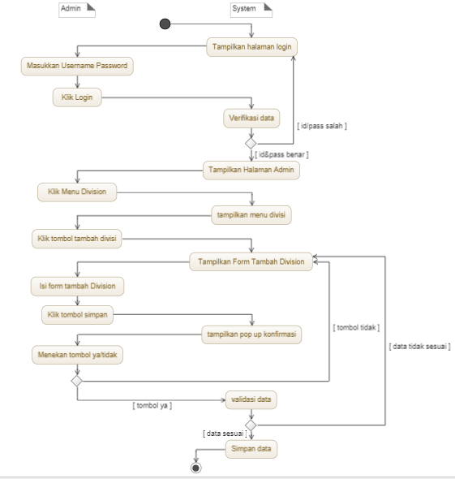
Activity tambah edit hapus lihat division, position & leave

Slide 20
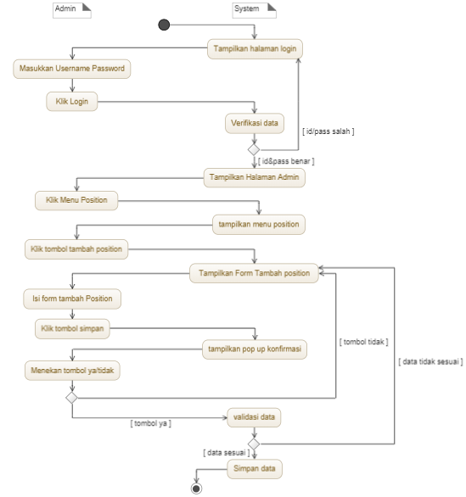
Activity tambah edit hapus lihat division, position & leave

Slide 21
Activity tambah edit hapus lihat division, position & leave

Slide 22
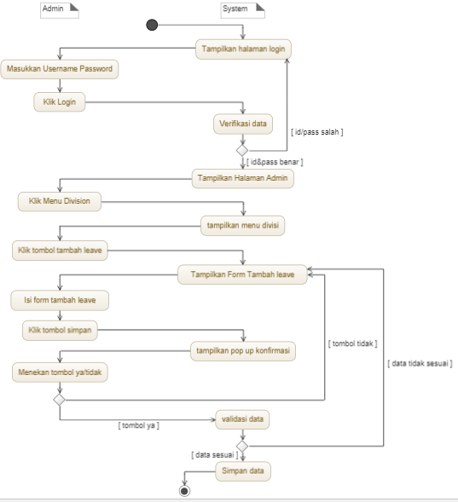
Activity tambah edit hapus lihat division, position & leave

Slide 23
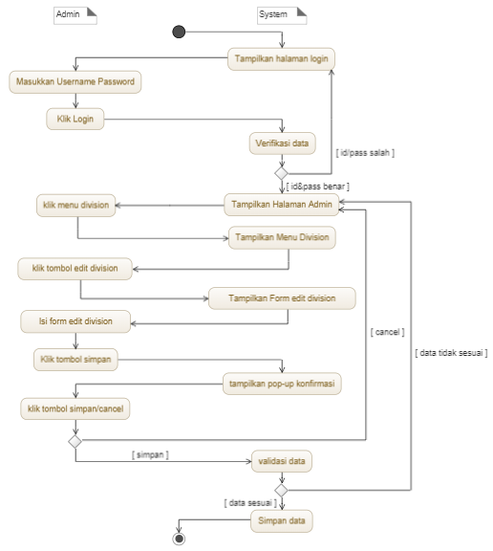
Activity tambah edit hapus lihat division, position & leave

Slide 24
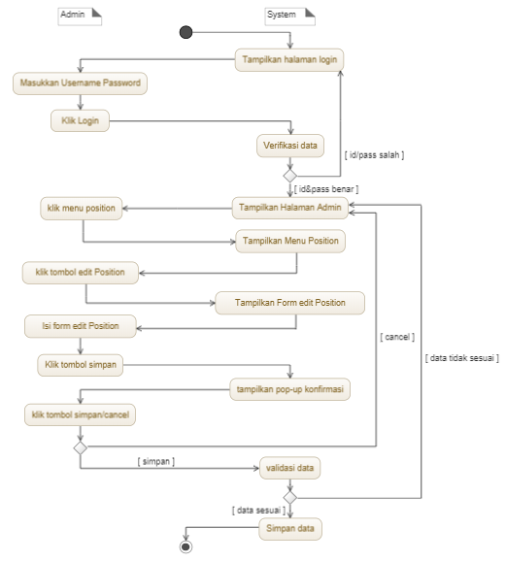
Activity tambah edit hapus lihat division, position & leave

Slide 25
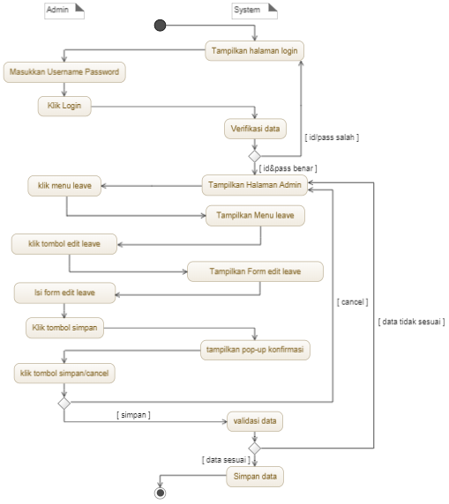
Activity tambah edit hapus lihat division, position & leave

Slide 26
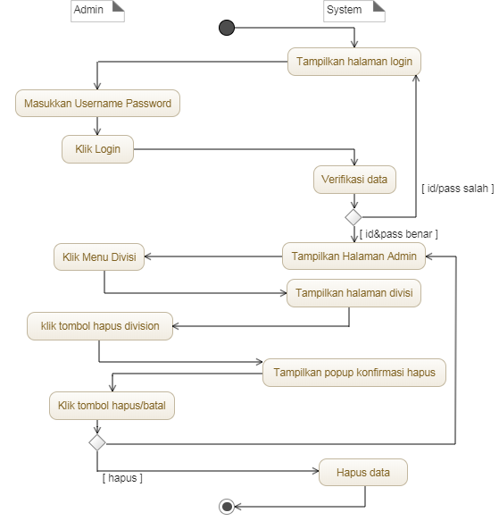
Activity tambah edit hapus lihat division, position & leave

Slide 27
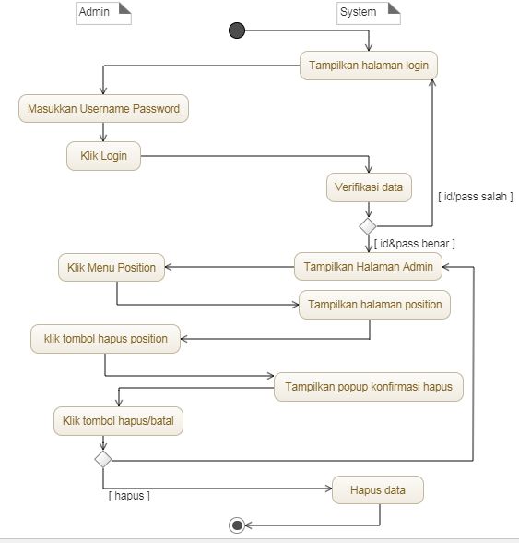
Activity tambah edit hapus lihat division, position & leave

Slide 28
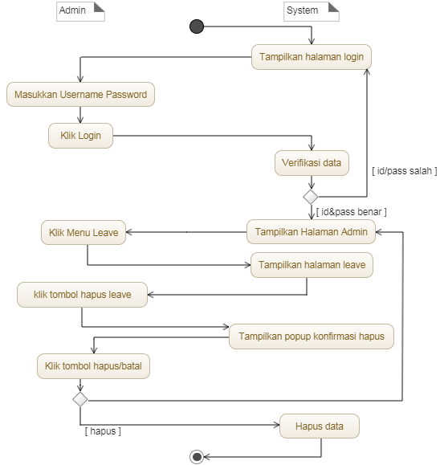
Activity tambah edit hapus lihat division, position & leave

Slide 29
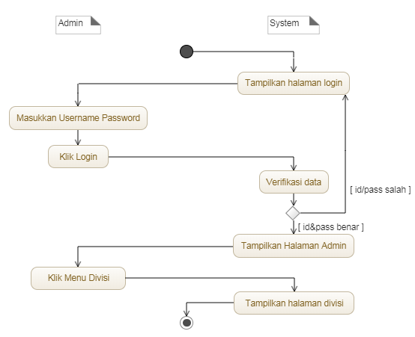
Activity tambah edit hapus lihat division, position & leave

Slide 30
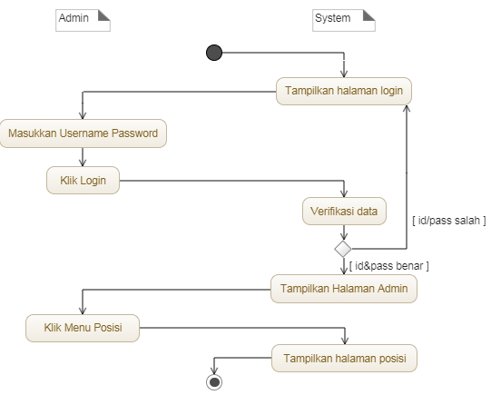
Activity tambah edit hapus lihat division, position & leave

Slide 31
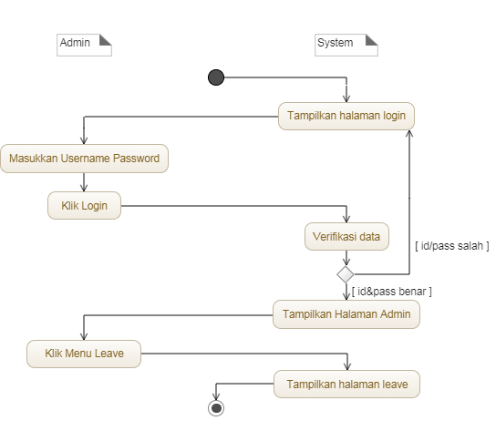
Activity tambah edit hapus lihat division, position & leave

Slide 32
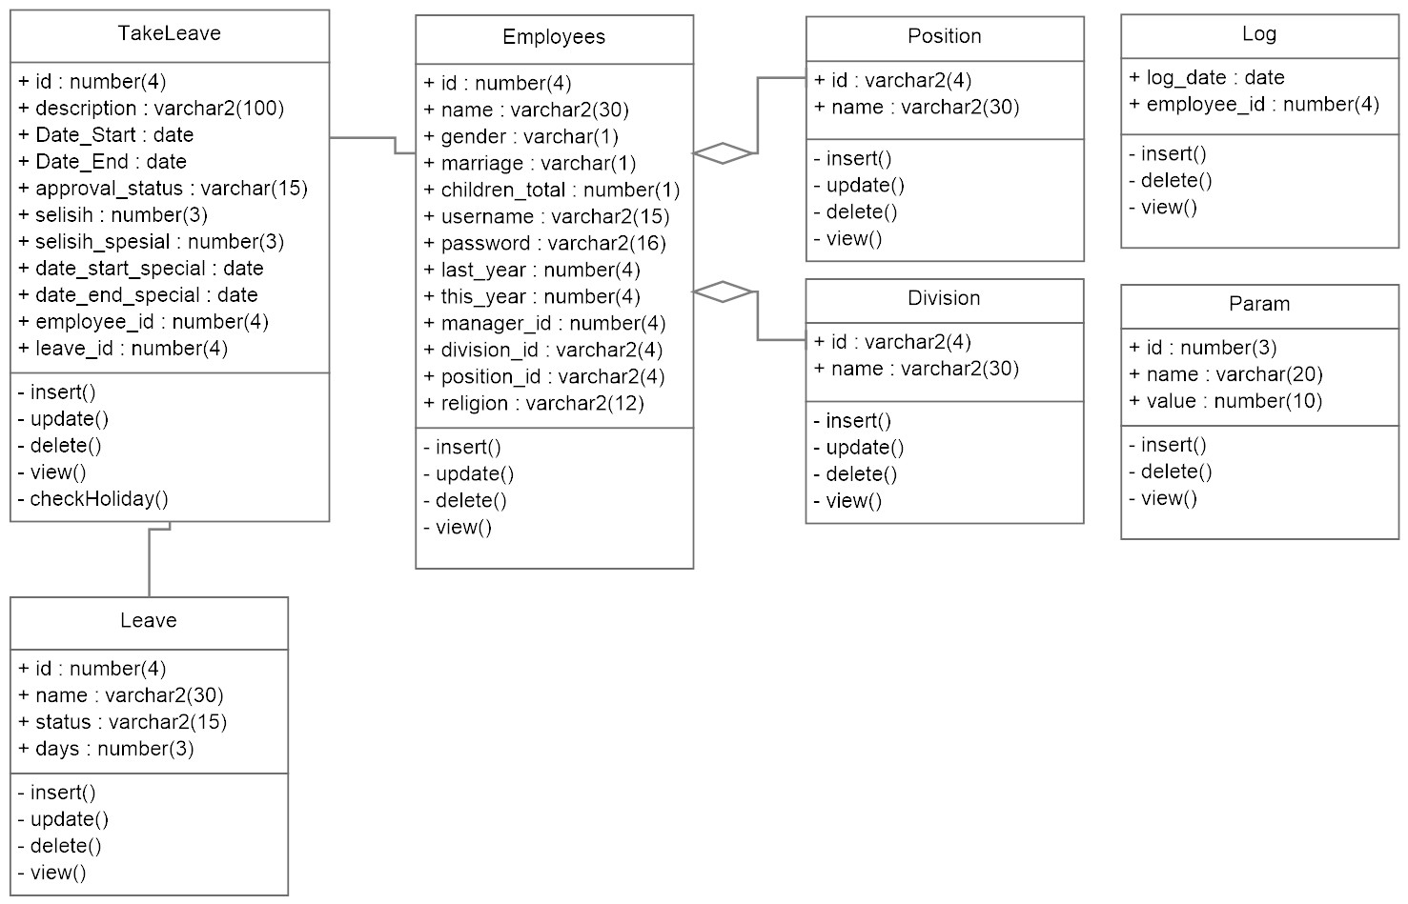
Class diagram

Slide 33
Penjelasan constraint ambil cuti
Gender | Marriage | Religion | Children | Cuti tidak bisa diambil
F | Y | Islam | - | Cuti Sunat & Cuti Menikah
F | Y | Non-Muslim | - | Cuti Sunat, Cuti Menikah, Cuti Umroh & Cuti Haji
F | N | Islam | - | Cuti Sunat & Cuti Melahirkan
F | N | Non-Muslim | - | Cuti Sunat, Cuti Melahirkan, Cuti Umroh & Cuti Haji
M | Y | Islam | >0 | Cuti Melahirkan & Cuti Menikah
M | Y | Non-Muslim | >0 | Cuti Melahirkan, Cuti Menikah, Cuti Umroh & Cuti Haji
M | N | Islam | - | Cuti Melahirkan & Cuti Sunat
M | N | Non-Muslim | - | Cuti Melahirkan, Cuti Sunat, Cuti Umroh & Cuti Haji

